Slide 1
LIS-S511: Database Design Virtual Symposium
Luddy School of Informatics, Computing, and Engineering
Lauren M. Harris
IUPUI
Notes:
• The presentation introduces the data book clearly and succinctly • The presentation provides information the context, users, and their information needs • The presentation provides an overview of the data types and data one would find in the database • The presentation shows a clear walkthrough of the ERD • The presentation includes reflections on your struggles and successes • The presentation includes insights into what you might do differently on your next database project • The presentation is supported by either a simple PowerPoint-style visual aid or a walk-through of data book products • The presentation was polished and did not include distractions • The presentation was around 10 minutes in duration • The presentation was accompanied by a .zip file/archive of your data book, parts one and two

Slide 2
Agenda
Data Narrative
Entity Relationship Diagram
Struggles
Successes
Next database project
Notes:
• The presentation shows a clear walkthrough of the ERD • The presentation includes reflections on your struggles and successes • The presentation includes insights into what you might do differently on your next database project • The presentation is supported by either a simple PowerPoint-style visual aid or a walk-through of data book products • The presentation was polished and did not include distractions • The presentation was around 10 minutes in duration • The presentation was accompanied by a .zip file/archive of your data book, parts one and two

Slide 3
Data Narrative
SECTION 1
Notes:
The presentation provides information the context, users, and their information needs • The presentation provides an overview of the data types and data one would find in the database •

Slide 4
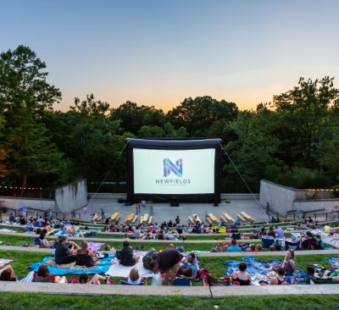

Summer Nights
Data Narrative
Photos courtesy of Newfields
Notes:
Summer Nights is the most popular and longest running program at Newfields.
Main users for this databook would be public programming staff

Slide 5
Facts about Summer Nights
Data Narrative
Started in 1979
The films are screened on Fridays and Saturdays from June to August
The movies are screened outdoors at The Amphitheater
Movies range from black and white to modern blockbusters
Notes:
Now the museum collobrates with organizations like The Heartland Film Festival and shows short films during the program run.

Slide 6



Is a movie critically acclaimed?
Data Narrative
Photos courtesy of Academy of Motion Picture Arts and Science, Dick Clark Productions, Screen Actors Guild-American Federation of Television and Radio Artists (SAG-AFTRA)
Notes:
The presentation provides information the context, users, and their information needs • The presentation provides an overview of the data types- I did put a limit of characters for primary keys
and data one would find in the database - actor names and dobs, same for directors, movie title, release year and genre, award winners the year the movies were released
If a movie is on a streaming site could that affect sales making the movie expensive to show

Slide 7




Who distributed the movie?
Data Narrative
Photos courtesy of A24, Metro-Goldwyn-Mayer Studios, Inc., Paramount Pictures Corporation, and Warner Bros. Entertainment Inc.
Notes:
. The department should be able to track the movies being shown at the institution, who the leading actors are, the director, and the release date. Knowing the release date is important since Newfields does promote the movies, movie studios have their own rules about distribution after being made available physically or digitally.
Knowing release year, staff can think about anniversary screenings
Realize if there is a bias of films being shown with actors, directors

Slide 8
Entity Relationship Diagram
SECTION 2
Notes:
The presentation shows a clear walkthrough of the ERD •

Slide 9
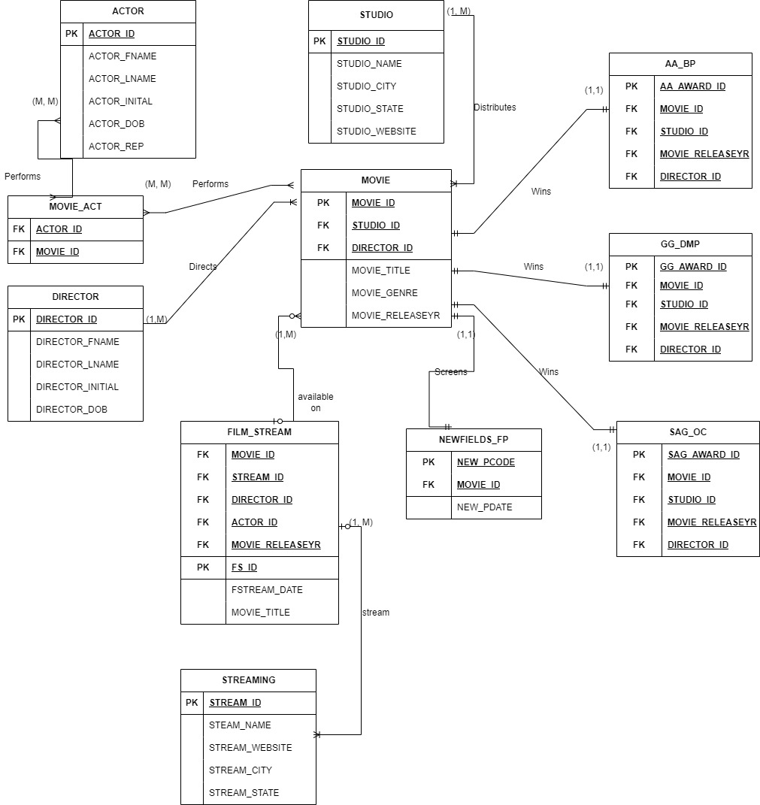
Overall ERD
Notes:
The presentation shows a clear walkthrough of the ERD
ACTOR, STUDIO, MOVIE, MOVIE_ACT, DIRECTOR, STREAMING, FILM_STREAM, NEWFIELDS_FP, AA_BP, GG_DMP, AND SAG_OC.

Slide 10
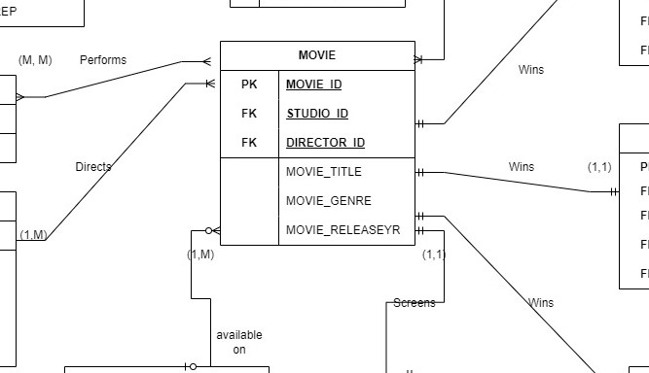
Notes:
The presentation shows a clear walkthrough of the ERD
ACTOR/MOVIE_ACT
Many ACTOR can star in many MOVIE_ACT
DIRECTOR/MOVIE
DIRECTOR can direct one or many MOVIE
STUDIO/MOVIE
STUDIO produces one or many MOVIE
NEWSFIELDS/MOVIE
NEWFIELDS shows one MOVIE on program date
FILM_STREAM/MOVIE
FILM_STREAM streams one or more MOVIE
MOVIE/AA_BP
Only one MOVIE wins AA_BP for that year
MOVIE/GG_DMP
Only one MOVIE wins GG_DMP for that year
MOVIE/SAG_OC
Only one MOVIE wins SAG_OC for that year

Slide 11
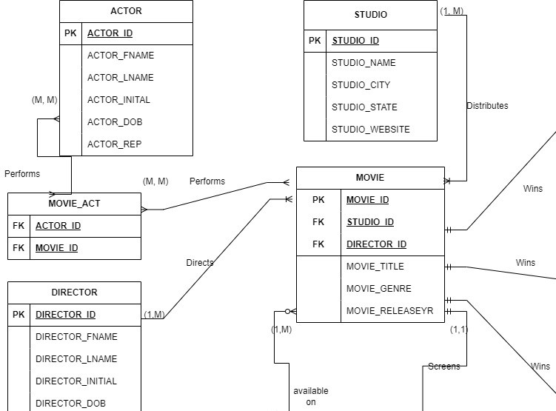
Notes:
Starting with the upper left quardent, the following entities
ACTOR/MOVIE_ACT
Many ACTOR can star in many MOVIE_ACT
DIRECTOR/MOVIE
DIRECTOR can direct one or many MOVIE
STUDIO/MOVIE
STUDIO produces one or many MOVIE

Slide 12
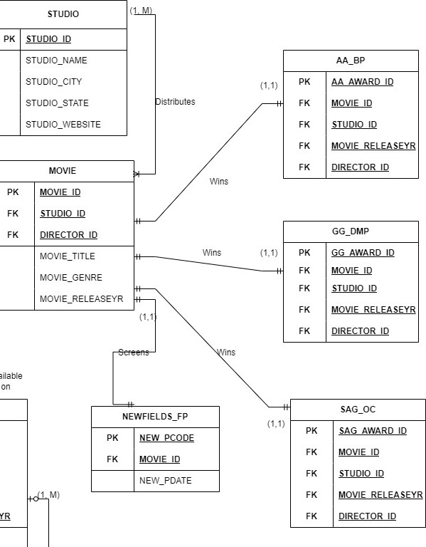
Notes:
MOVIE/AA_BP
Only one MOVIE wins AA_BP for that year
MOVIE/GG_DMP
Only one MOVIE wins GG_DMP for that year
MOVIE/SAG_OC
Only one MOVIE wins SAG_OC for that year

Slide 13
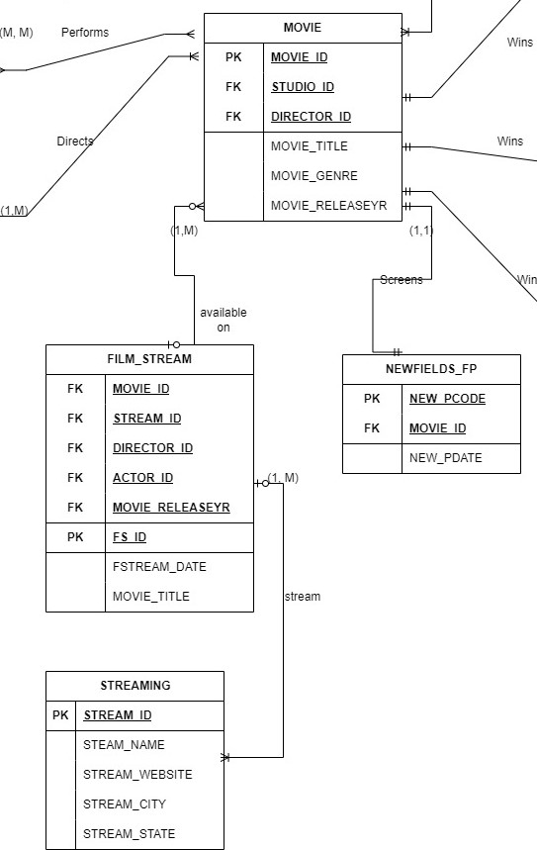
Notes:
Below Movie has Newfields film programming and streaming tables
NEWSFIELDS/MOVIE
NEWFIELDS shows one MOVIE on program date
FILM_STREAM/MOVIE
FILM_STREAM streams one or more MOVIE

Slide 14
Struggles and Successes
Section 3
Notes:
The presentation includes reflections on your struggles and successes

Slide 15
Struggles
Knowing what attributes to add to entities
Linking ACTOR to MOVIE
SQL subquery query
Studio merges
Notes:
Knowing what attributes to add to entities
Linking ACTOR to MOVIE
SQL subquery query
Studio merges

Slide 16
Successes
Completing the assignment
Separating awards
Notes:
Completing the assignment
Separating awards

Slide 17
Next database project
Section 4
Notes:
• The presentation includes insights into what you might do differently on your next database project • The presentation is supported by either a simple PowerPoint-style visual aid or a walk-through of data book products • The presentation was polished and did not include distractions • The presentation was around 10 minutes in duration • The presentation was accompanied by a .zip file/archive of your data book, parts one and two

Slide 18
Changes
Next database project
Remove ACTOR?
Include prices of tickets, number/ type of guests, and location
Staff members who worked
Include non-English films

Slide 19
I would be remiss if I did not thank Diana Gingerich, Lindsay Hammon, the rest of the public programming department, and volunteers at Newfields for providing information about Summer Nights and other film programming.

Slide 20
Thank you

